Slide 1
Please feel free to change slide titles, add graphics, and add slides as needed to individualize your presentation to your research!
Division of Dental Medicine
Title Slide
Project Title - Should be short and descriptive (10 words or less and no acronyms)
Subtitles
  Your Name
  Additional names of authors with degrees
  Place a comma between author’s names
  Authorship indicates involvement in all 3 of these areas:
    the study design
    data collection and analysis
    writing and editing the presentation
  Affiliations
  Name of Department, Institution, location, etc.
  All authors and their affiliations should be recognized.

Slide 2

            NYU Langone Hospital Brooklyn GPR Program

Slide 3
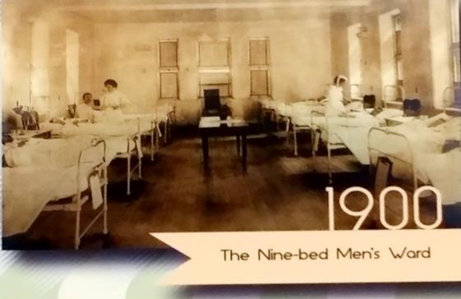
NYU Langone health
NYU Langone Hospital Brooklyn previously known as Lutheran Medical center was established in 1883 by Sister Elisabeth Fedde with nine beds

Slide 4
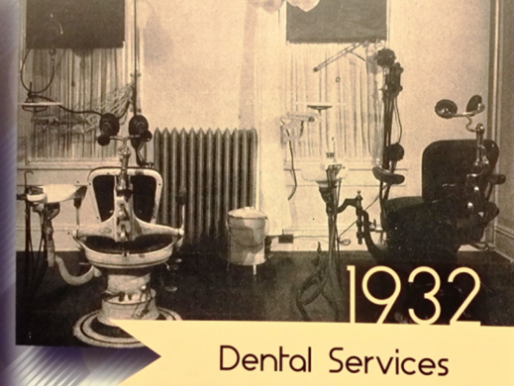
Division of Dental Medicine
The first dental chair was added in 1932.

Slide 5
In 1967, Sunset Family Health Center was established and the dental clinic opened.
In 1973, the dental residency program started.

Slide 6
Today NYU Langone Brooklyn (formerly Lutheran Hospital) is a full service 464-bed academic teaching Level 1 trauma hospital.
It consists of nine primary care sites, thirty one school-based health centers, three daycare centers and one center for extended care and rehabilitation.
New York State’s largest behavioral health program.
Largest Dental Residency program in the country.

Slide 7
GPR Program
Is a one year program with second year optional
20 first year residents and 3 second years
The residents clinical training happens at three different sites all closely proximated to each other.
Sunset Family Health Center
Park Ridge Family Health Center
Park Slope Family Health Center

Slide 8
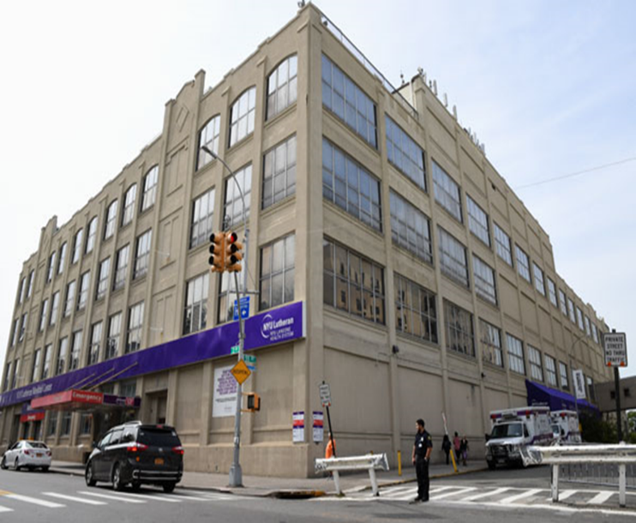
Sunset Family Health Canter

Slide 9
Sunset Family Health Center
Established in 1967 and is located inside the NYU langone Hospital in Brooklyn
Dental Clinic
- 15 operatories equipped with digital x-ray, laser, 3D cone beam, in-house lab, microscopes, rotary endodontic equipment, digital impression.

Slide 10
Sunset Park Family Health Center
The primary training site for the GPR program
Level 1 Trauma Center
Full accreditation in 2016
ER, Anesthesia and OR training is provided at this site

Slide 11
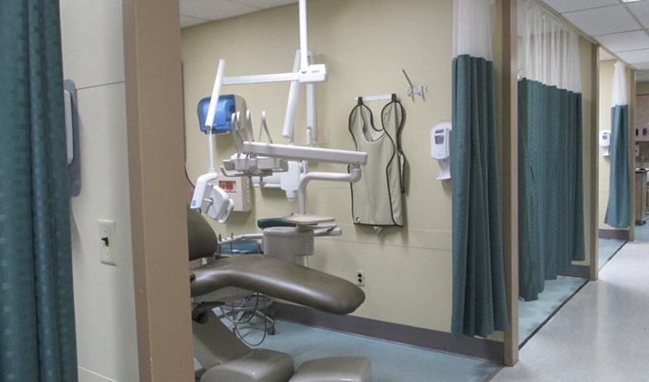
Notes:
Perio, peds, OS, TMD, oral medicine, invisalign, special patient care,

Slide 12
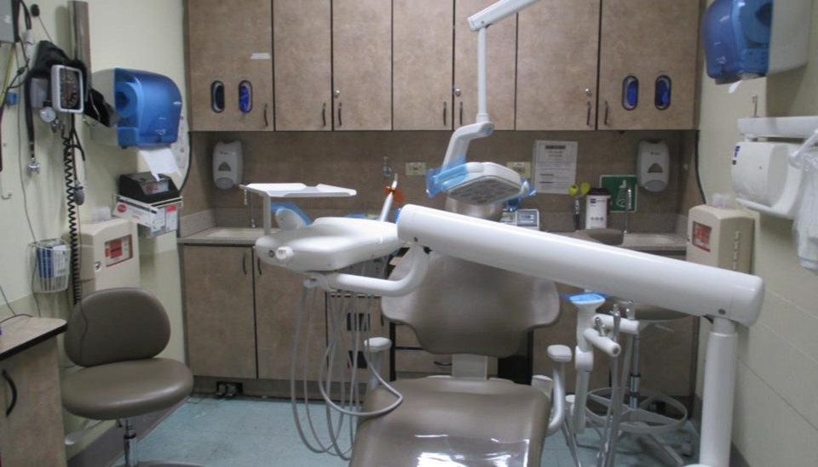
.
Notes:
See many patients, fast paced dental clinic with a wide variety of procedures as patients are typically not referred out to other specialties
Paired with dental assistant throughout the session, eager and incredibly helpful attendings and a team-oriented environment assures providers have the time to learn while building their speed and skillset

Slide 13
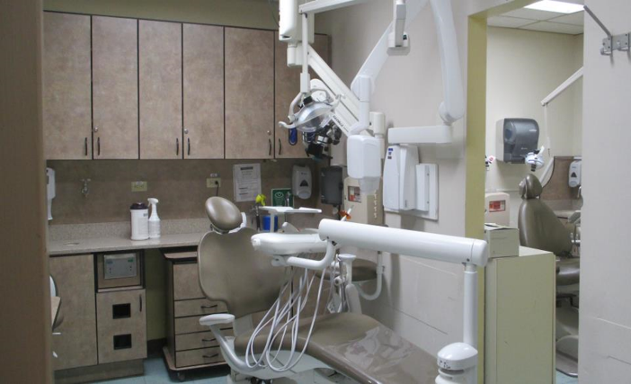
Notes:
Two 12 hours days and three 8 hour days starting at 8:15am
1-2 saturdays / month (9am-3pm)
As for the on call schedule .. There is always a resident on call for dental emergencies with the frequency being shared by a rotation of all 20 residents
Residents are not required to stay in the hospital overnight while on call

Slide 14
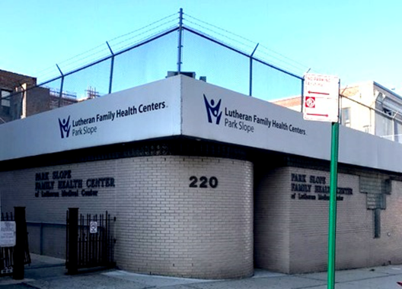
Park Slope Family Health Center
Notes:
In order to better serve a larger portion of the community, residents will be rotating to one of two offsites for 1-3 days of the week , with the exact number varying month to month
The park slope family health center Located in the charming neighborhood Park Slope, park slope family health center is located 2 miles from the hospital

Slide 15
Park Slope Family Health Center
Established in 1990.
Located on 13th street in Park Slope.
Dental Department: 4 operatories and is equipped with digital x-ray and rotary endodontic equipment
GP, pediatric attendings

Slide 16
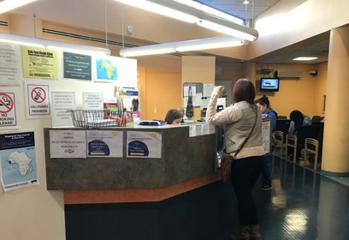
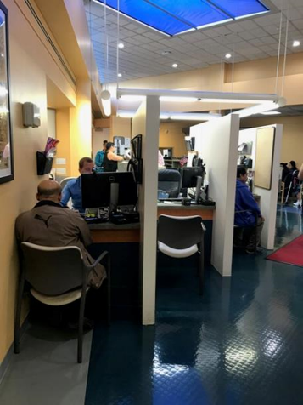
Park Slope Family Health Center

Slide 17
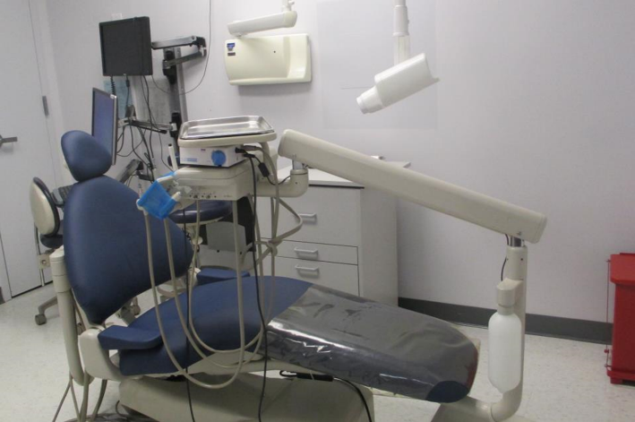
Notes:
Similar to the main site, both of the offsites will also be staffed with one on one assistants

Slide 18
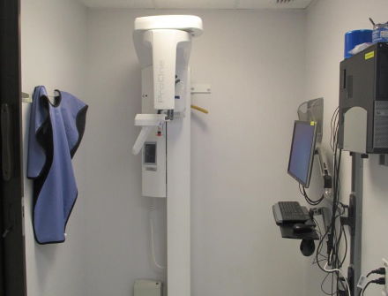
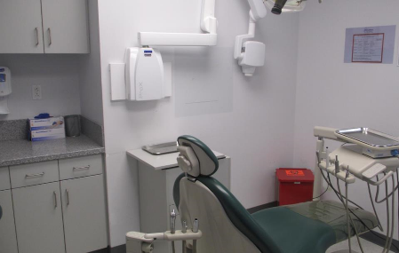

Slide 19
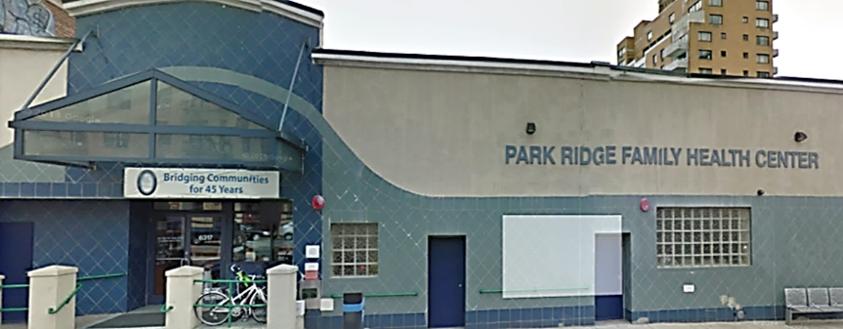
Park Ridge Family Health Center

Slide 20
Park Ridge Family Health Center
Established in July 1997
Located on 4th Avenue and 63rd street in Brooklyn
Originally designed for five operatories. In 2013, two more operatories were added.
Equipped with digital x-ray, 3D cone beam, rotary endodontic equipment, and multiple implant systems
GP, Oral Surgery, Perio, Pros, TMD, and Pediatric attendings

Slide 21
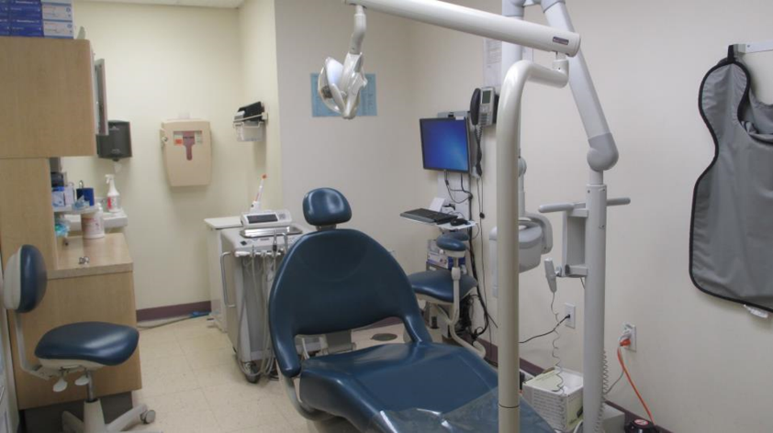

Slide 22
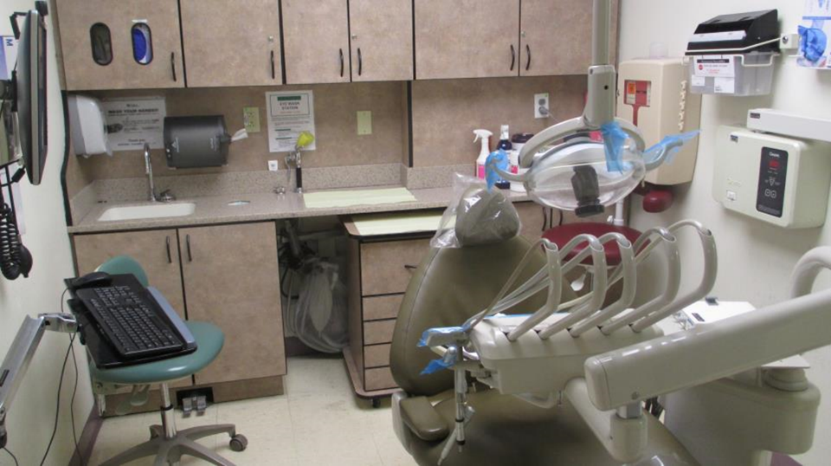

Slide 23
Off- Clinic Rotations
The residents are assigned to
ER/ Medicine rotation (90 hours)
Anesthesia rotation (90 hours)
OR rotation (40 hours)

Slide 24
Didactics
Bright space Modules: On line lectures
Regional days: Lit review and case presentations
Thursday Meetings

Slide 25
